Slide 1

Getting Data Online
STAT 474 – Techniques for Large Data Set
Notes:
Are your classroom colors different than what you see in this template? That’s OK! Click on Design -> Variants (the down arrow) -> Pick the color scheme that works for you!
Feel free to change any “You will…” and “I will…” statements to ensure they align with your classroom procedures and rules!

Slide 2
Getting Data Online
Data and information has been available online in many forms (file links, text on webpages, API, etc.)
Open government initiative to promote transparency.
Blogs, twitters, Facebook posts become ubiquitous.
Web scraping = converting (unstructured) data on webpage to the structured form
Ways to scrap data:
Human Copy-and-Paste
Text pattern matching
API interface
DOM Parsing

Slide 3
Automate File Downloading
Many data repositories organize data in multiple data files (e.g., grouping by years, locations, etc.)
Possible to manually download one at a time, but boring and time-consuming.
Most have names following some patterns. Can be exploit to automate the process.
In R: download.file(url, destfile, …)
url = string of the link to the file
destfile = location where the file will be stored
Activity: ASA Data Challenge in 2009 is about domestic airline flights. Visit the webpage and write a script to automatically download the data files.
http://stat-computing.org/dataexpo/2009/the-data.html

Slide 4
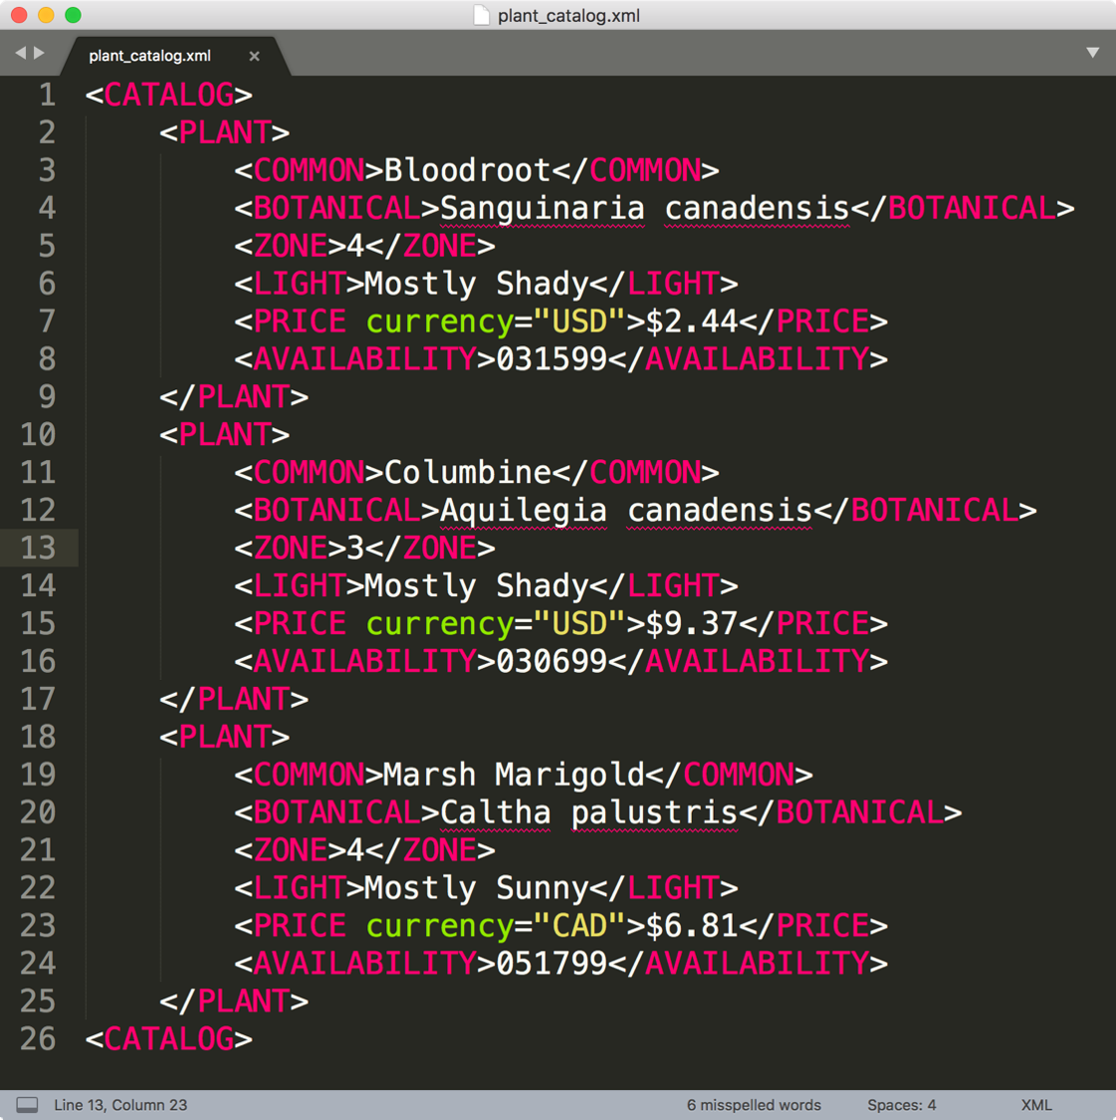
Reading Data from static webpages
Most of the webpages are written in HTML, one of the variant of XML (eXtensible Markup Language).

Slide 5
HTML/XML Syntax: Element/Node
The basic unit of XML code is called an "element" or "node".
Each node has a start tag and end tag.
<zone> 4 </zone>
Tag names are case-sensitive with no spaces between < and tagname. Must begin with a letter and contain only alphanumeric characters.
Start tag
Format: <∙∙∙>
End tag Format: </∙∙∙>
Content: anything between start and end tags.

Slide 6
XML/HTML Syntax: Nesting
A note may contain other nodes (children) in addition to plain text content.
Indention is not needed, but often employed for clarity.
<plant>
<zone> 4 </zone>
<light> Mostly Shady </light>
</plant>
Tag must be properly nested.
Start tag
Content consists of two nodes
End tag

Slide 7
XML/HTML Syntax: Empty Nodes
Nodes may be empty (intentional or unintentional)
Example: <plant> <zone></zone> <light/> </plant>
An element must have both an open and closing tag. However, if it is empty, then it can be of the form <tagname/>.
To describe less than or larger than, use &lt; and &gt; respectively.

Slide 8
XML/HTML Syntax: Attributes
Nodes may have attributes (and attribute values)
<plant id=‘a’> <zone></zone> <light source=“2” class=“new”/> </plant>
All attribute’s values must appear in quotes. name = “value”
Comments can be anywhere, between <!-- and -->
Attribute named id has a value “a”
Empty node has two attributes: source and class

Slide 9
A Simple HTML Document
<!DOCTYPE html>
<html>
<head>
<title>Page Title</title>
</head>
<body>
<h1>My First Heading</h1>
<p>My first paragraph.</p>
</body>
</html>

Slide 10
Simple Web Scrapping with R
Learn to write a html website at https://www.w3schools.com/html/default.asp
Data might be organized as a table on a webpage.
Extract the table by looking for the tag <table>
Open the file simple2.html for structure of a table
R package rvest provides tools to extract such data
Demo: extract info about countries from Wikipedia
https://en.wikipedia.org/wiki/List_of_countries_by_population_(United_Nations)

Slide 11
Scrapping HTML Nodes
We can scrap data from different HTML nodes:
h1, h2, …, h6: section, subsection headings
ul, ol: unordered and ordered lists
We can scrap data from HTML attributes
Node <a> with href attribute provides links to other webpages.
Many tools to identify specific nodes to scrap:
Chrome/Firefox browser built-in: developer tools
Chrome extension selector, obtained from selectorgadget.com
Activity: Scrapping data from Wikipedia

Slide 12
HTTP Hypertext Transfer Protocol
Created at CERN by Tim Berners-Lee in 1989 as part of the World Wide Web
Started as a simple request-response protocol used by web servers and browsers to access hypertext
Widely used to exchange data and to provide services:
Access webpage and submit forms
Common API (Application Programming Interface) to access data and services across the internet
Foundation of modern REST APIs (Representational state transfer)…

Slide 13
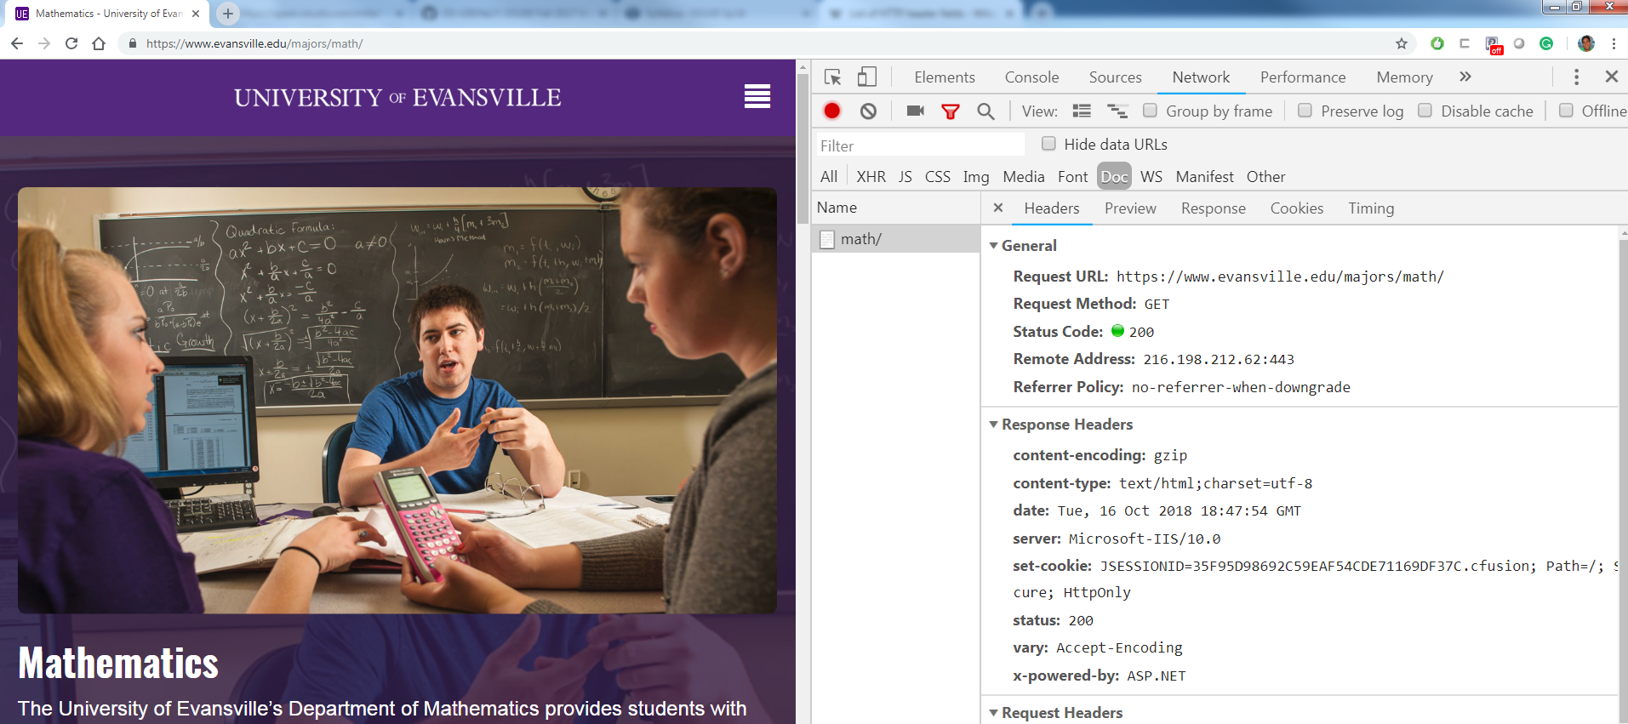
In a web browser

Slide 14
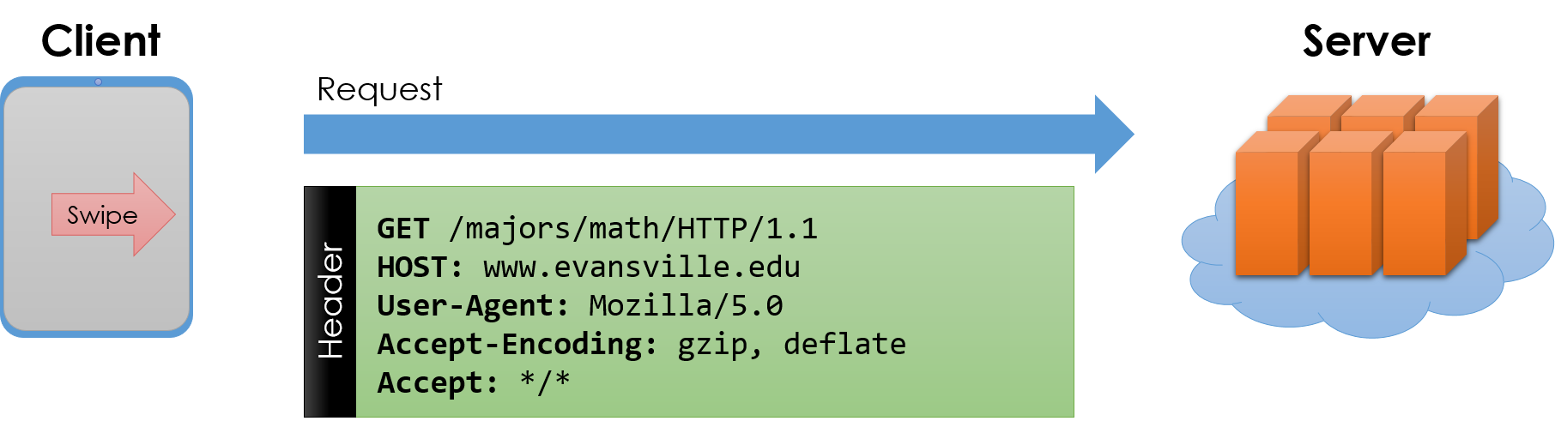
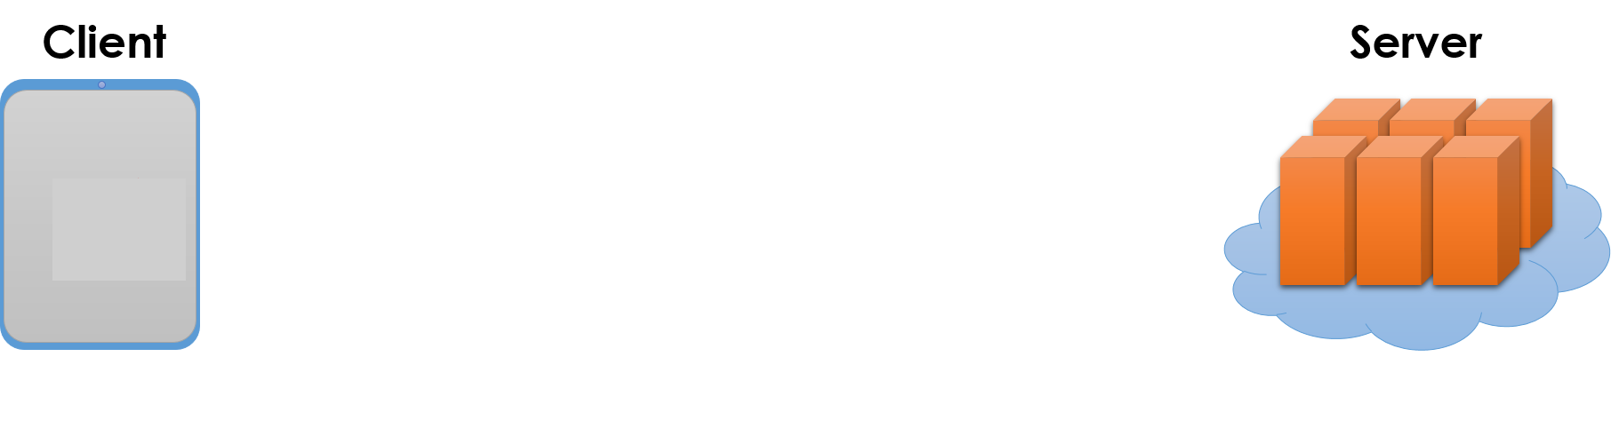
Request – Response Protocol
Request’s 1st line contains:
A method: GET or POST
A URL or a path to the document
Protocol and its version
Remaining header lines:
Key-value pairs
Other attributes
(Optional) Body
Extra parameters & data
Notes:
GET : request method
POST : get the data from user

Slide 15
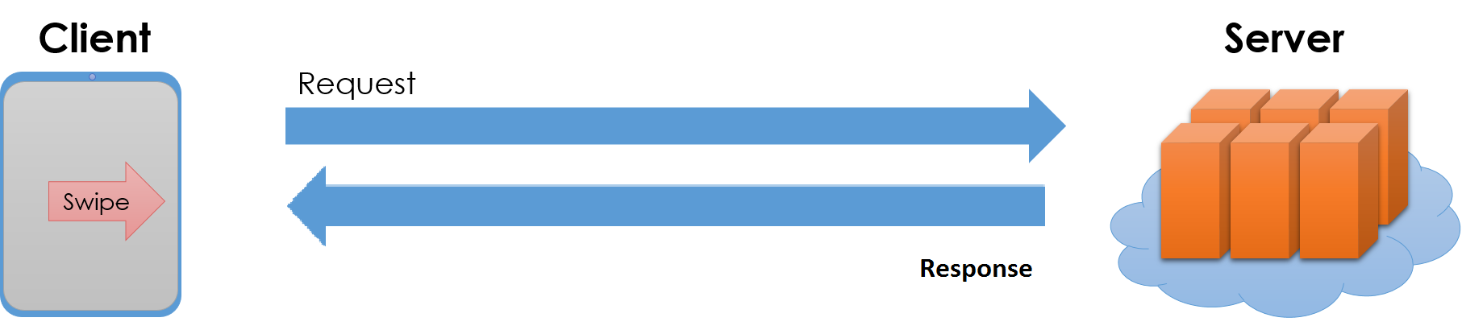
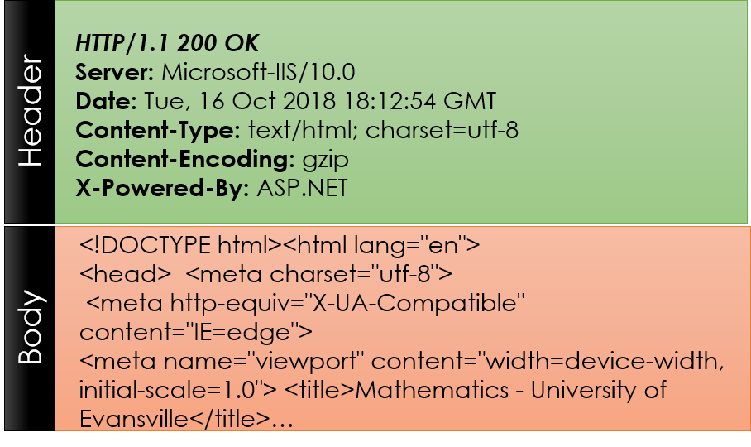
Request – Response Protocol

Slide 16
Common Request Types
GET – get information
Parameters passed in URI (Uniform Resource Identifier) (limited to ~2000 characters)
/app/user_info.json?username=tuan&version=now
Request body is typically ignored
Should not have side-effects (e.g., update user info)
Can be cached in on server, network, or in browser
POST – send information
Parameters passed in URI and BODY
May and typically will have side-effects
Often used with web forms

Slide 17
Response Status Codes
100s Informational – Communication continuing. more input expected from client or server
200s Success – 200: General success
300s Redirection or Conditional Action – requested URL is located somewhere else
400s Client Error
404 indicates the document was not found
403 indicates that the server understood the request but refuses to authorize it
500s Interval Server Error or Broken Request – error on the server side

Slide 18
Example of using HTTP
Renewable energy initiative has been emphasized in California for the past decade.
Historic data on renewable energy can be found at: https://ww2.energy.ca.gov/almanac/renewables_data/solar/index_cms.php
We want to collect data from this website for all available years.

Slide 19
Getting data from APIs
API (Application Programming Interface) an interface that sits on top of a system and simplifies certain tasks, e.g., extracting a subset from a database.
Web APIs are a way to strip away all the extraneous visual interface and get the data you want.
Why should we use Web APIs
Get information that would be either time-consuming or impossible to get otherwise.
Automate an analytical workflows that require continuously updated data
Access data using a more direct interface.

Slide 20
Getting data from APIs
APIs are accessed using request-response protocol.
API Endpoints: data sources available through an API.
REST = Representational State Transfer; intuitively, a resource (either from software or from web services)
can use a URL as the address of a given resource
A resource can be a document as HTML page
A resource can be full or subset of a data set.
Most of systems require authentication via username and password or private token keys.
Demo: Medical Guideline API.

